Slide 1
Green energy
A project made by :
Chiş Raluca
Fîciu Alexandra
Achinca Mălina
Coordinating teachers :
Niculescu Elisabeta
Manicea Iulia
“Tudor Vianu” National High school of Computer Science

Slide 2
Fossil fuels are a finite resource that take millions of years to develop and will continue to diminish with use. Alternative sources of energy that could replace fossil fuels become a reality and ,more importantly, a necessity.

Slide 3
Green energy comes from natural sources such as sunlight, wind, rain, tides, plants, algae and geothermal heat, all of which
are renewable, meaning they're naturally replenished.

Slide 4
History tells us that these sources of energy, now viewed as alternatives, were once the primary sources of energy used by people to heat their homes, cook their food, and do their work.
For what reason did we become dependent on fossil fuels and how did earth’s original sources of energy come to be seen as alternatives?

Slide 5
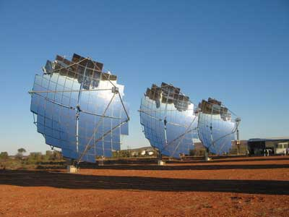
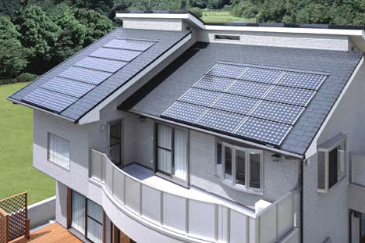
Solar energy is a completely renewable resource. Even when we cannot make use of the sun’s power because of night time or cloudy and stormy days, we can always rely on the sun showing up the very next day as a constant and consistent power source.
Oil burning releases harmful greenhouses gases, carcinogens and carbon dioxide into the air. Solar energy is much more practical than oil because it creates absolutely no pollution.

Slide 7
Another source of green energy are the waves.

Slide 8
“Of all the renewable, the most predictable are the tides in the ocean. If the tides give out, it means you have much bigger problems. You’ve lost the moon or the sun.” John Topping, of the Washington, D.C.–based Massachusetts Tidal Energy

Slide 9
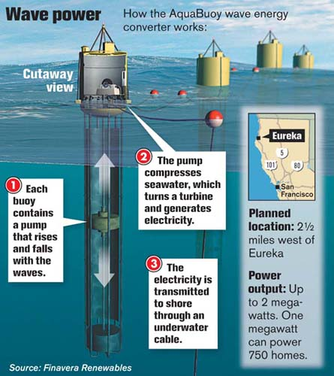

Slide 10
Hydrogen cells
There have been produced several cars that rely only on hydrogen cells and guess what: it works, it actually does, despite people’s skepticism.
More than 500 are on the road today. A BMW prototype attained a top speed of 186 miles an hour. Even more exciting, there is a project which has as purpose the production of a car like this that could be stored in a normal garage.

Slide 12
Wind power
Wind turbines provide energy thanks to the wind which, as it is well known, is an endless source of energy.
The wind will never stop blowing, therefore this is an endless source of energy, as well as a constant one.

Slide 14
”Always available, naturally renewing and running at an energy-packed 98.6 degrees Fahrenheit, the human body seems a useful green energy option for the future.”
Kate Freeman, former Mashable reporter based in San Francisco.

Slide 15
Nanotechnology ?
Thermodynamics ?

Slide 18
Humid continental climate

Slide 19
Local transport Noise

Slide 20
Water consumption
Sustainable utilization of land
Biodiversity

Slide 21
The Europe’s first "green capital"

Slide 25
“Heat exchangers in the Central Station's ventilation system convert the excess body heat into hot water. That is then pumped to the heating system in the nearby building to keep it warm. In practice, the system lowers the energy costs of the building by 25%”, says a BBC article.

Slide 26
Let’s turn one's clothing and accessories into a personal powerhouse.

Slide 27
The researchers at the U.S. Department of Energy’s Lawrence Berkeley National Laboratory

Slide 28
created a body heat energy-harnessing jacket using silicon nanowire technology.

Slide 29
…to charge cell phones and other electronic devices on your person.

Slide 30
Next station: London

Slide 31
A researcher at the London Centre for Nanotechnology developed a cell phone power source that uses solar cells and light from OLED to produce an overall longer battery life, continues Kate Freeman.

Slide 32
Or imagine the stones made from stainless steel, with a shell made of temperature-absorbing material that, dropped into your morning cup of Joe, capture excess heat and then slowly dissipate it back in the coffee ensuring a hot cup for a longer period of time.

Slide 33
Sources
Peggy Daniels Becker (Book Editor), “Alternative Energy” , Farmington Hills, Greenhaven Press , 2010,
Dan Chiras, “Solar Electricity Basics” , Canada, New Society Publishers, 2010
http://upload.wikimedia.org/wikipedia/commons/b/bb/Alternative_Energies.jpg
http://hntvzx360c.info/wp-content/uploads/2013/06/Solar-Power.jpg
http://upload.wikimedia.org/wikipedia/commons/e/e5/12-05-08_AS1.JPG
http://4.bp.blogspot.com/-thFhlcfxwSo/Tilqtvzw8kI/AAAAAAAAAOc/yyl1Aa6_FSc/s1600/solar+energyyy.jpg
http://4.bp.blogspot.com/-7ZtL5B-AEOE/TafBAHRxrxI/AAAAAAAABH8/o8I3RhoUZNE/s1600/mn_wave_power.jpg
http://automobilein.com/ocean-wave-wallpaper/
http://2.bp.blogspot.com/-h_tVDfGDJMo/T2iQClYp15I/AAAAAAAAGbE/lHM48smW2u8/s1600/waves.jpg
http://oceana.org/sites/default/files/explore/science/ocean076ocewav_012.jpg
http://worldoceanreview.com/wp-content/uploads/2010/10/7_12-c-simulated-wave-farm.jpg
http://www.arup.com/~/media/Images/Projects/P/Pelamis/pelamis_900x600_pelamiswavepower.ashx?mh=800&mw=1000
http://i.telegraph.co.uk/multimedia/archive/02007/wind_2007865b.jpg
http://www.green-the-world.net/images/renewable-energy-sources.jpg

Slide 34
http://en.wikipedia.org/wiki/Stockholm
http://www.alternative-energy-news.info/technology/inventions/
http://www.xtended.se/?attachment_id=303
http://www.timeout.com/stockholm/
http://www.tripadvisor.com/Tourism-g189852-Stockholm-Vacations.html
http://travelwithscott.com/2012/05/04/top-this/
http://en.hdyo.org/tee/questions
http://thecityfix.com/blog/crowdsourcing-energy-in-public-spaces/
http://www.lbl.gov/LBL-PID/Berkeley-Lab-history.html
http://www.takepart.com/article/2013/01/17/your-own-body-heat-our-next-renewable-energy-source
http://chargeall.com/cellphonebatterychargertips/
http://www.visitlondon.com/
http://en.wikipedia.org/wiki/London_Centre_for_Nanotechnology
http://www.cruisingfromstockholm.com/

Slide 35
https://www.google.ro/search?q=wind+turbine&source=lnms&tbm=isch&sa=X&ei=ZGI4U9KKEIiChQfp84CwBw&ved=0CAYQ_AUoAQ&biw=1366&bih=667#facrc=_&imgdii=_&imgrc=k3gbCwfYuIc2LM%253A%3Bwdk-8tDfImwMmM%3Bhttp%253A%252F%252Fwww.aahplanning.com%252Fnews%252Fwp-content%252Fuploads%252F2011%252F10%252Fwindmill-imgae-for-website.jpg%3Bhttp%253A%252F%252Fwww.aahplanning.com%252Fnews%252F99%252Faah-planning-wind-turbine-planning-specialists%3B1811%3B2714

